Slide 1
THREEJS
LUCAS SOLANIK and GERI VIALLON

Slide 2
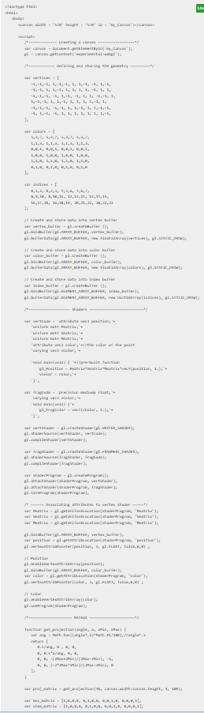
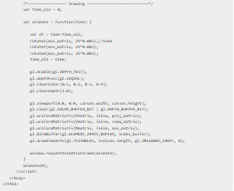
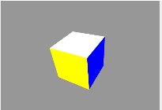
How THREEJS came to be
Cross browser JavaScript Library and API
3D library used in websites
Builds using a Scene, Camera, Object and Renderer
Often uses webGL but is NOT webGL
Created to make webGL more useful

Slide 3
Uses for THREEJS
OUTSIDE OF WEB DEVELOPMENT
Game Development
Advertising and Marketing
Education and E-Learning
Extended Reality
WITHIN WEB DEVELOPMENT
Home pages
Capabilities

Slide 4


Websites who have mastered THREEJS

Slide 5
OUR WEBSITE

Slide 6
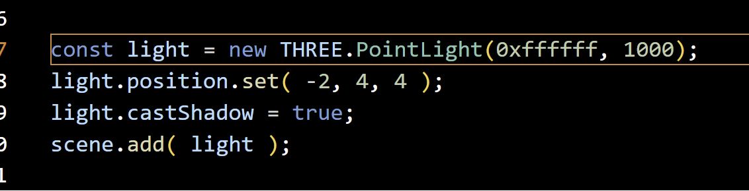
Crux of the code
ThreeJS boilerplate!
(you need a scene, a camera, a renderer, an object. If one is missing, you have a blank screen!)
ThreeJS.org -> Documentation -> installation

Slide 7
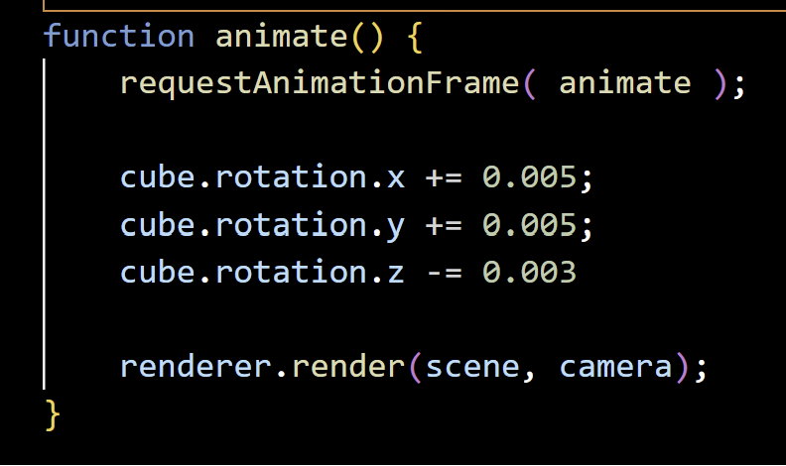
Crux of the code

Slide 8
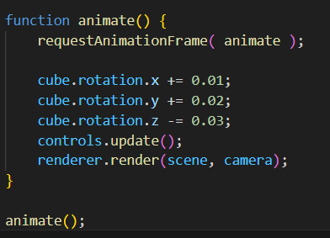
Crux of the code

Slide 9
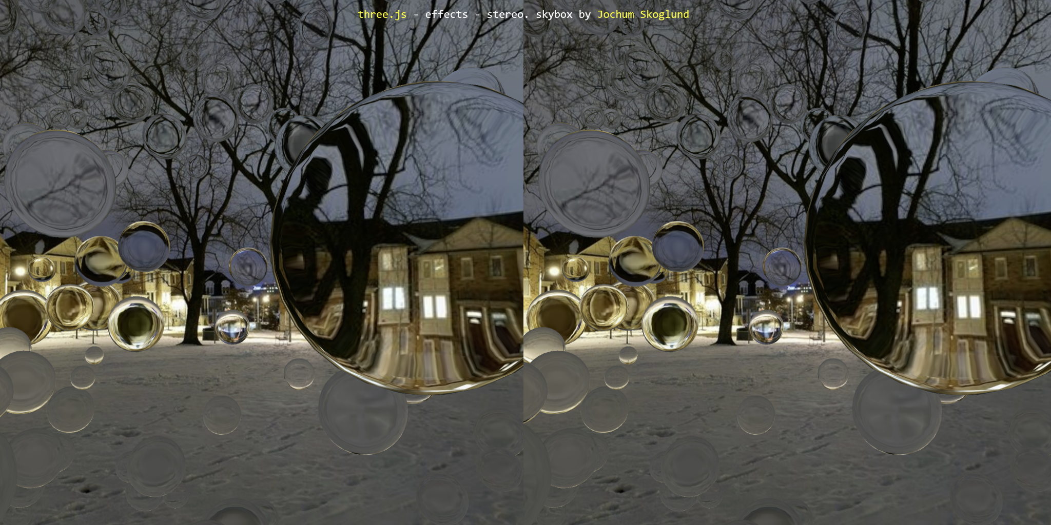
Conclusion
ThreeJS makes complex 3D much easier!

